Slide 1

Processing sequences using RNN and CNN
Hands-On Machine Learning Part2
& Deep Learning from Scratch 3
TAVE Research DL001
Heeji Won

Slide 2
Contents
01. RNN
02. BPTT
03. Overcoming the Unstable Gradient Problem
04. Overcoming the short-term memory
Appendix. Deep Learning from Scratch

Slide 3
Contents
01. RNN
02. BPTT
03. Overcoming the Unstable Gradient Problem
04. Overcoming the short-term memory
Appendix. Deep Learning from Scratch

Slide 4
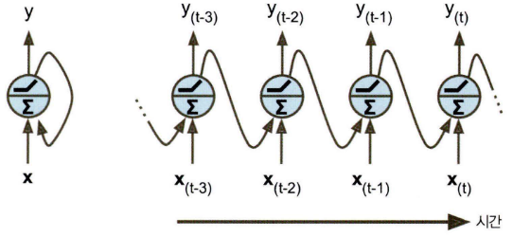
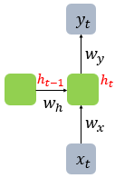

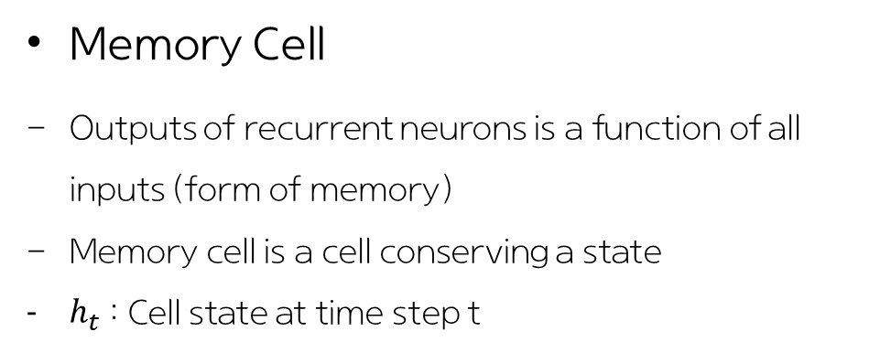

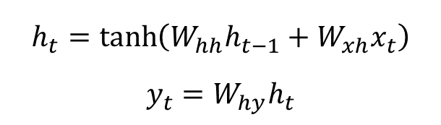

01. RNN
: Sequence model for sequential time series data
Memory Cell
Outputs of recurrent neurons is a function of all inputs (form of memory)
Memory cell is a cell conserving a state
$h_{t}$ : Cell state at time step t
Recurrent Neuron
$$h_{(t−1)}$$
$$h_{(t)}$$
(Vanilla) RNN
Unrolling the network through time
$$h_{t}=\tanh\left(W_{hh}h_{t−1}+W_{xh}x_{t}\right)$$
$$y_{t}=W_{hy}h_{t}$$
$$h_{t}=f_{W}(h_{t−1}, x_{t})$$
The same function and the same parameters are used at every time step!

Slide 5
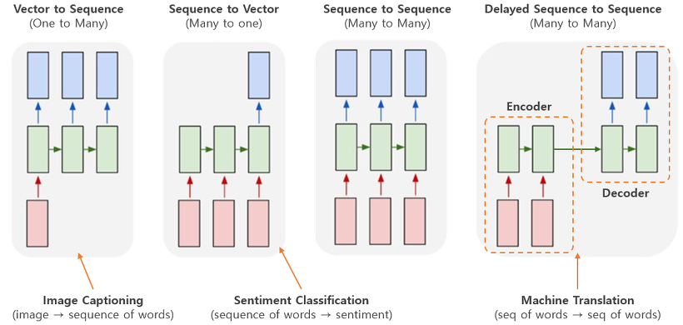
01. RNN
: Sequence model for sequential time series data
Various Input and Output

Slide 6
Contents
01. RNN
02. BPTT
03. Overcoming the Unstable Gradient Problem
04. Overcoming the short-term memory
Appendix. Deep Learning from Scratch

Slide 7
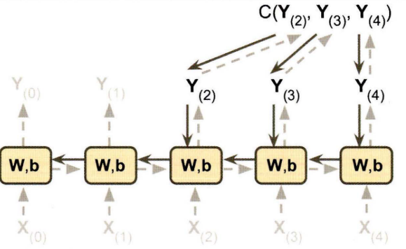

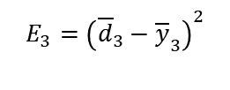

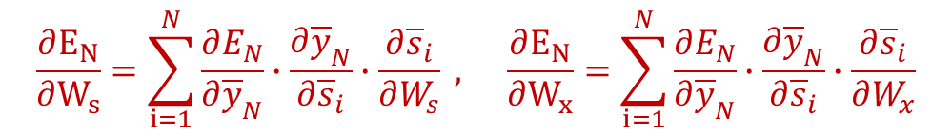
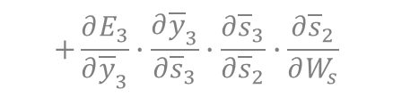




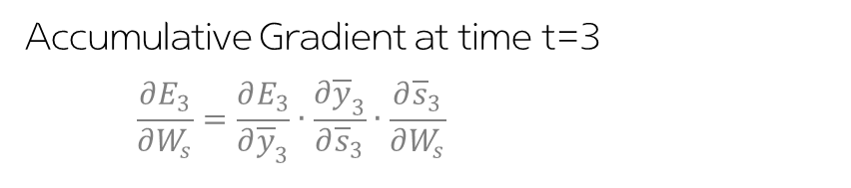










02. BPTT (backpropagation through time)
: Gradient-based technique for training RNN
$$E_{3}={\left({\overline{d}}_{3}−{\overline{y}}_{3}\right)}^{2}$$
$W_{y}$
$$\frac{∂{\overline{y}}_{3}}{∂{\overline{s}}_{3}}$$
$$\frac{∂{\overline{s}}_{1}}{∂W_{s}}$$
$$\frac{∂{\overline{s}}_{2}}{∂{\overline{s}}_{1}}$$
$$\frac{∂{\overline{s}}_{3}}{∂{\overline{s}}_{2}}$$
${\overline{S}}_{1}$
${\overline{S}}_{2}$
${\overline{S}}_{3}$
$W_{s}$
$W_{s}$
$W_{s}$
$W_{x}$
$W_{x}$
$W_{x}$
${\overline{x}}_{1}$
${\overline{x}}_{2}$
${\overline{x}}_{3}$
Accumulative Gradient at time t=3
$$\frac{∂E_{3}}{∂W_{s}}=\frac{∂E_{3}}{∂{\overline{y}}_{3}}∙\frac{∂{\overline{y}}_{3}}{∂{\overline{s}}_{3}}∙\frac{∂{\overline{s}}_{3}}{∂W_{s}}$$
$$+\frac{∂E_{3}}{∂{\overline{y}}_{3}}∙\frac{∂{\overline{y}}_{3}}{∂{\overline{s}}_{3}}∙\frac{∂{\overline{s}}_{3}}{∂{\overline{s}}_{2}}∙\frac{∂{\overline{s}}_{2}}{∂W_{s}}$$
Backpropagate from outputs calculating cost function (ignoring other outputs)
Accumulate gradients
Why? Outputs depends on previous time steps
$$+ \frac{∂E_{3}}{∂{\overline{y}}_{3}}∙\frac{∂{\overline{y}}_{3}}{∂{\overline{s}}_{3}}∙\frac{∂{\overline{s}}_{3}}{∂{\overline{s}}_{2}}∙\frac{∂{\overline{s}}_{2}}{∂{\overline{s}}_{1}}∙\frac{∂{\overline{s}}_{1}}{∂W_{s}}$$
$$\frac{∂E_{N}}{∂W_{s}}=\sum_{i=1}^{N}{\frac{∂E_{N}}{∂{\overline{y}}_{N}}∙\frac{∂{\overline{y}}_{N}}{∂{\overline{s}}_{i}}∙\frac{∂{\overline{s}}_{i}}{∂W_{s}} ,} \frac{∂E_{N}}{∂W_{x}}=\sum_{i=1}^{N}{\frac{∂E_{N}}{∂{\overline{y}}_{N}}∙\frac{∂{\overline{y}}_{N}}{∂{\overline{s}}_{i}}∙\frac{∂{\overline{s}}_{i}}{∂W_{x}}}$$

Slide 8
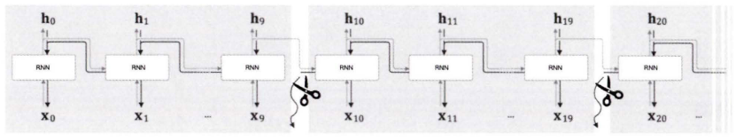
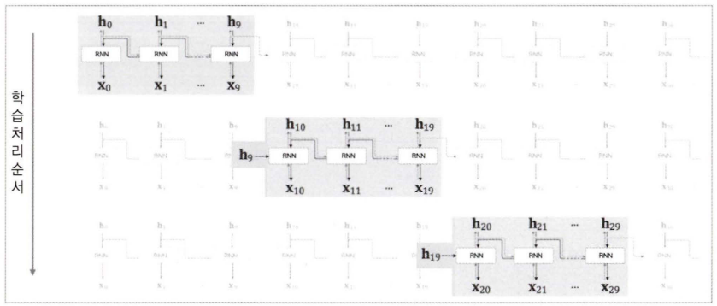
02. BPTT (backpropagation through time)
Truncated BPTT
BPTT has vanishing and exploding gradient problems and lots of calculations => Truncate!
Truncate only Backward Pass
(not forward pass)
Generally truncate per about 5 steps

Slide 9
Contents
01. RNN
02. BPTT
03. Overcoming the Unstable Gradient Problem
04. Overcoming the short-term memory
Appendix. Deep Learning from Scratch

Slide 10
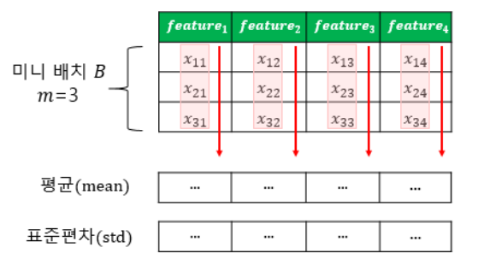
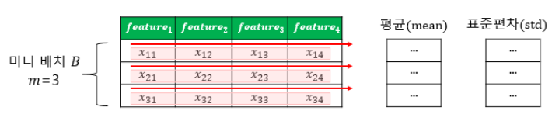
03. Overcoming the Unstable Gradient Problem
Non-Converged function
Non-converged function make exploding gradients (or outputs)
Why? the same weights are used in every time steps
=> Gradient Clipping
Layer Normalization
: normalization features of each sample using each parameter
cf) Batch Normalization
Also, we can use Dropout

Slide 11
Contents
01. RNN
02. BPTT
03. Overcoming the Unstable Gradient Problem
04. Overcoming the short-term memory
Appendix. Deep Learning from Scratch

Slide 12
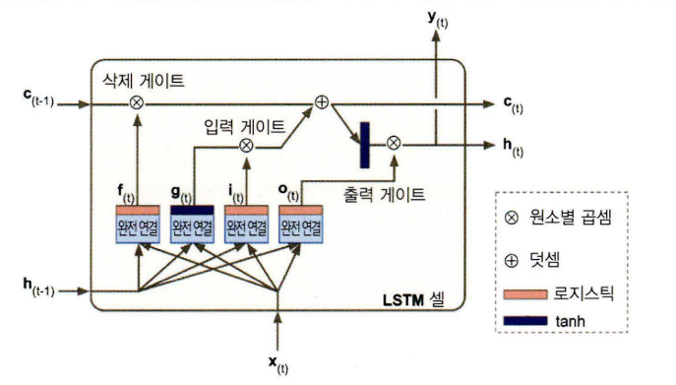
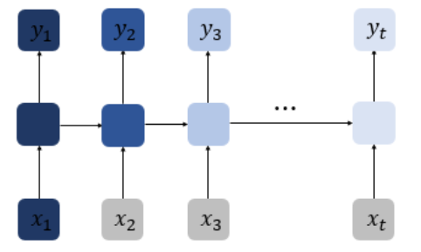
03. Overcoming the Short-Term Memory
LSTM Cell (Long short-term memory)
Solve Long-Term Dependencies problem
Structure
As t increases, RNN cannot preserve information over many time steps
There are three gates
(Input gate, Forget gate, Output gate)

Slide 13
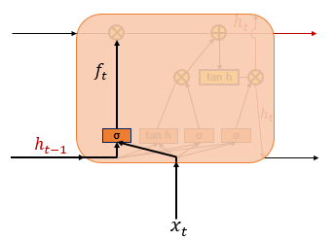
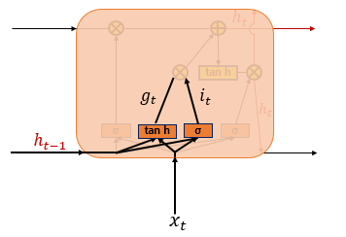


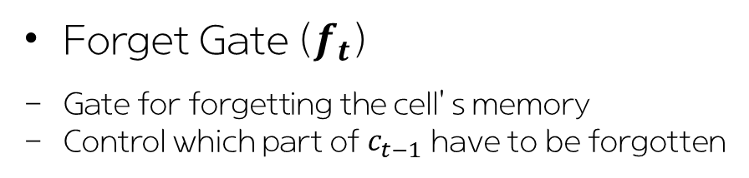
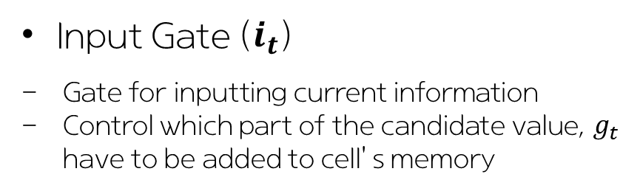
03. Overcoming the Short-Term Memory
LSTM Cell (Long short-term memory)
Forget Gate ($f_{t}$)
Gate for forgetting the cell’s memory
Control which part of $c_{t−1}$ have to be forgotten
Input Gate ($i_{t}$)
Gate for inputting current information
Control which part of the candidate value, $g_{t}$ have to be added to cell’s memory
0 ~ 1
-1 ~ 1

Slide 14
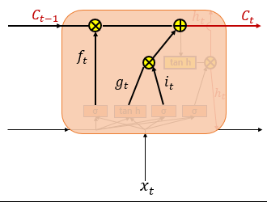
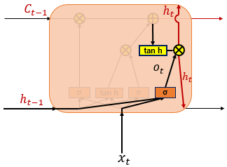


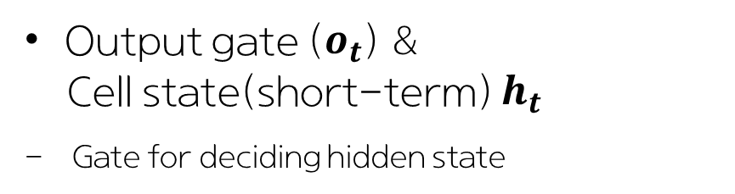

03. Overcoming the Short-Term Memory
LSTM Cell (Long short-term memory)
Cell state(long-term) $c_{t}$
Update the old cell state $c_{t−1}$
Output gate ($o_{t}$) &
Cell state(short-term) $h_{t}$
Gate for deciding hidden state

Slide 15
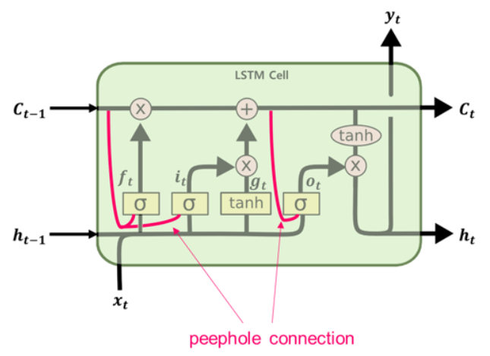
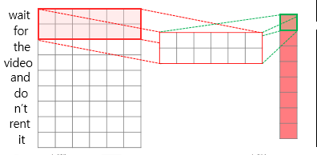
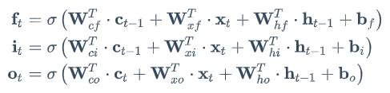
03. Overcoming the Short-Term Memory
Peephole Connection
1D Convolution layer
Gates also consider the long-term memory, $c_{t−1}$
1D Conv layer can help detect long-term pattern by reducing length of sequence
1D CNN (kernel size : 2)
Q : Why is this a 1D CNN not a 2D CNN?
A : Kernel moves in 1 direction

Slide 16
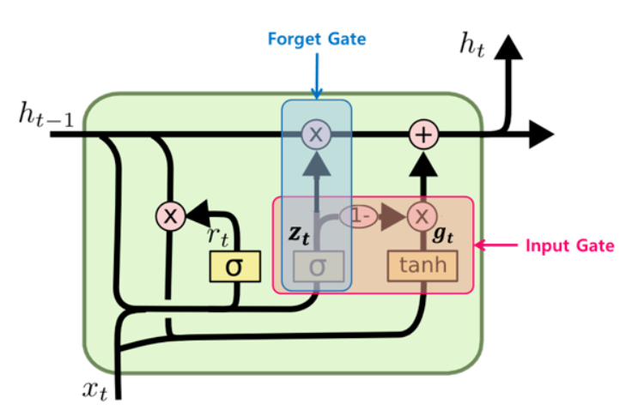
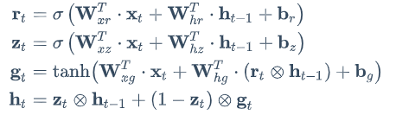
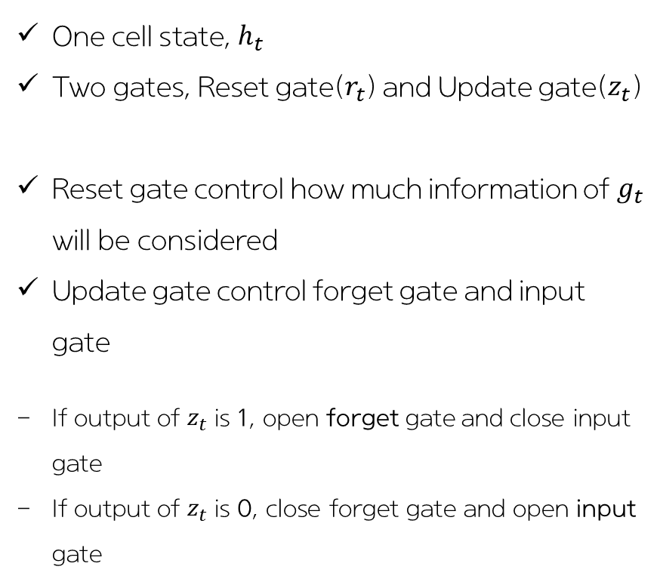
03. Overcoming the Short-Term Memory
GRU Cell (gated recurrent unit)
Simplified version of LSTM
One cell state, $h_{t}$
Two gates, Reset gate($r_{t}$) and Update gate($z_{t}$)
Reset gate control how much information of $g_{t}$ will be considered
Update gate control forget gate and input gate
If output of $z_{t}$ is 1, open forget gate and close input gate
If output of $z_{t}$ is 0, close forget gate and open input gate

Slide 17
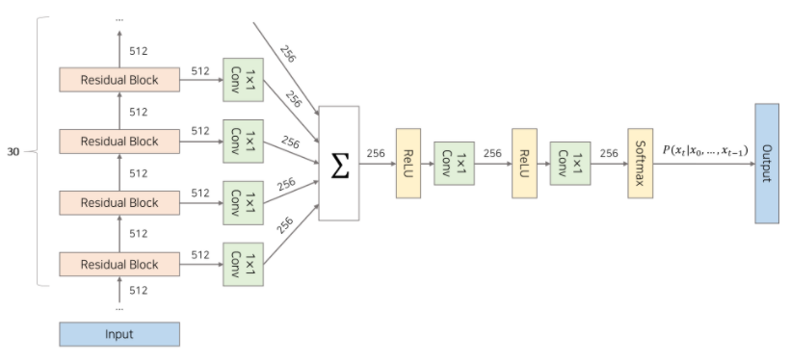
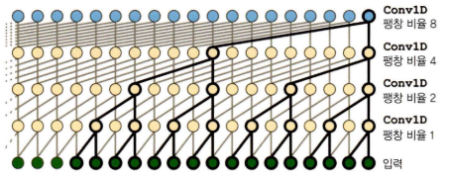
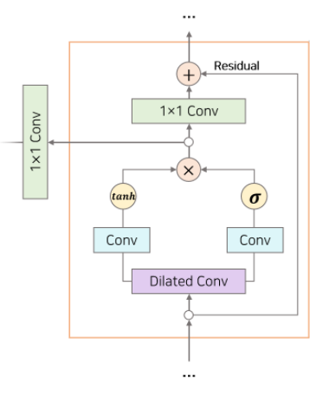

03. Overcoming the Short-Term Memory
WaveNet
< Overall Structure >
Dilated Convolution Layer
The dilation rate is doubled for each layer
The lower layers may identify short-term patterns, while the higher layers may identify long-term patterns
Causal Padding : padding the layer's input with zeros in the front
Filter
Gate
Gated Activation Unit

Slide 18
Contents
01. RNN
02. BPTT
03. Overcoming the Unstable Gradient Problem
04. Overcoming the short-term memory
Appendix. Deep Learning from Scratch

Slide 19
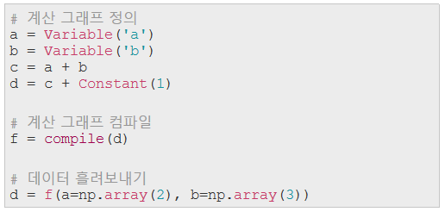

Appendix. Deep Learning from Scratch
Define-and-Run
Network is defined and fixed. And then data are fed into the predefined network
Easy to optimize
difficult to debug
Define-by-Run
Network is defined dynamically via the actual forward computation
This dynamic definition allows conditionals and loops into the network easily

Slide 20
Thank you

